Slide 1
Python Boot Camp
Welcome!
Notes:
Slack?

Slide 2
What is Data Science?
Analyzing data to make useful conclusions
Computational Skills
Math & Statistics
Domain Knowledge
Biology → Bioinformatics
Chemistry → Cheminformatics
Business → Business Analytics

Slide 3

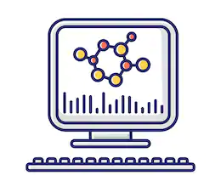
Bioinformatics

Slide 4
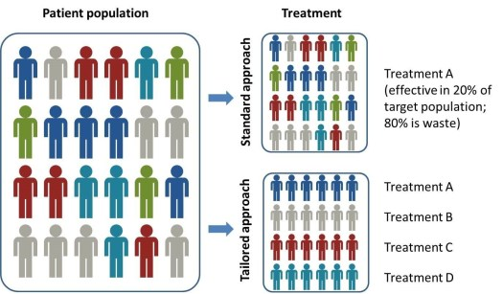
Precision Medicine

Slide 5



Precision Medicine
Precision Medicine
Demographic and Clinical Information
Biomarkers
EHR
Genomics
Pharmaco-
genomics

Slide 6
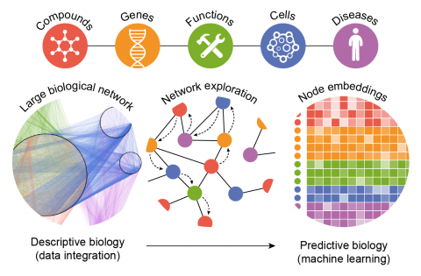
Data Science for Drug Discovery

Slide 7
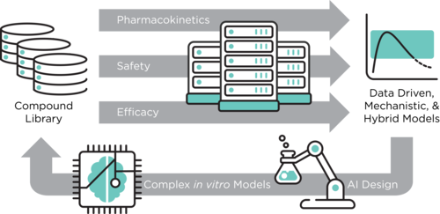
The ATOM Modeling Pipeline (AMPL)

Slide 8
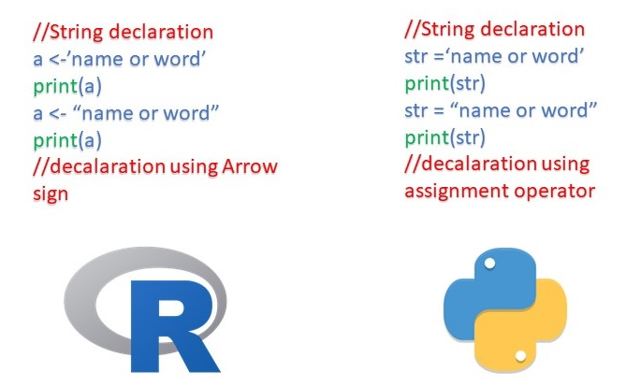
Programming Languages
The main differences are how commands are written, what extra “modules” are available
Learning 1 language makes it much easier to learn others
Python is one of the top languages for Data Science
Python

Slide 9
Bootcamp Outline
Week 1 | Week 2
Introduction & Installation (10 am ET), Start Udemy course Objects & data structures | Using Python modules & packages, Intro to pandas
Comparisons & statements | Indexing data with pandas
Methods & Functions | Data visualization (matplotlib, pandas, seaborn)
Mini-project | Data visualization & statistics
Finish mini-project | Principle Components Analysis

Slide 10
Installing Anaconda
Anaconda is a convenient software package that includes Python and lots of useful libraries
Installation
https://docs.anaconda.com/anaconda/install/
Then select Windows or MacOS
Python 3.x version
Windows users: Do add Anaconda as PATH environment variable!

Slide 11
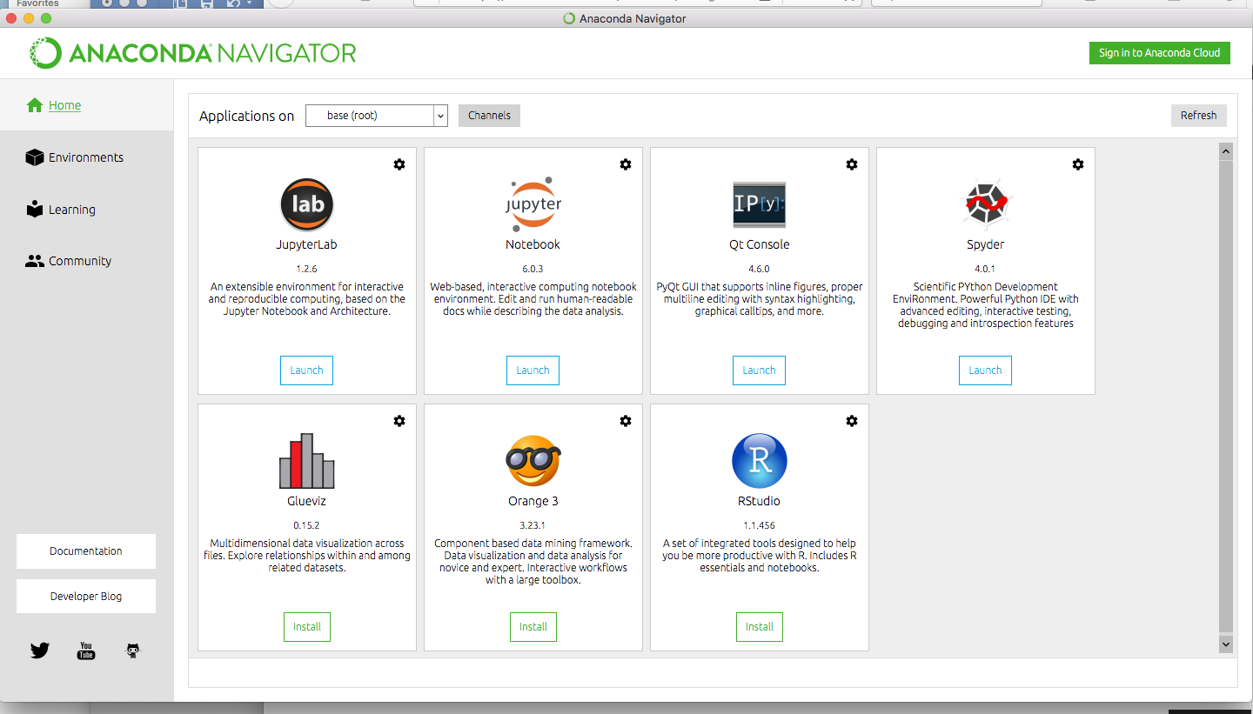
Starting Python through Anaconda

Slide 12
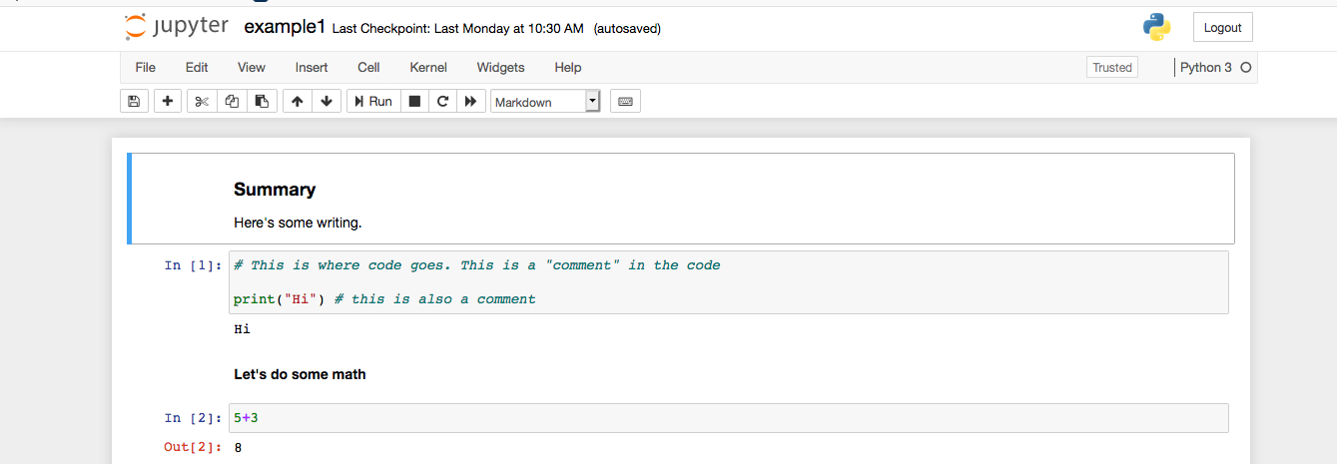
Jupyter Notebooks
Jupyter allows you to combine your report (normal, formatted text) with Python code

Slide 13
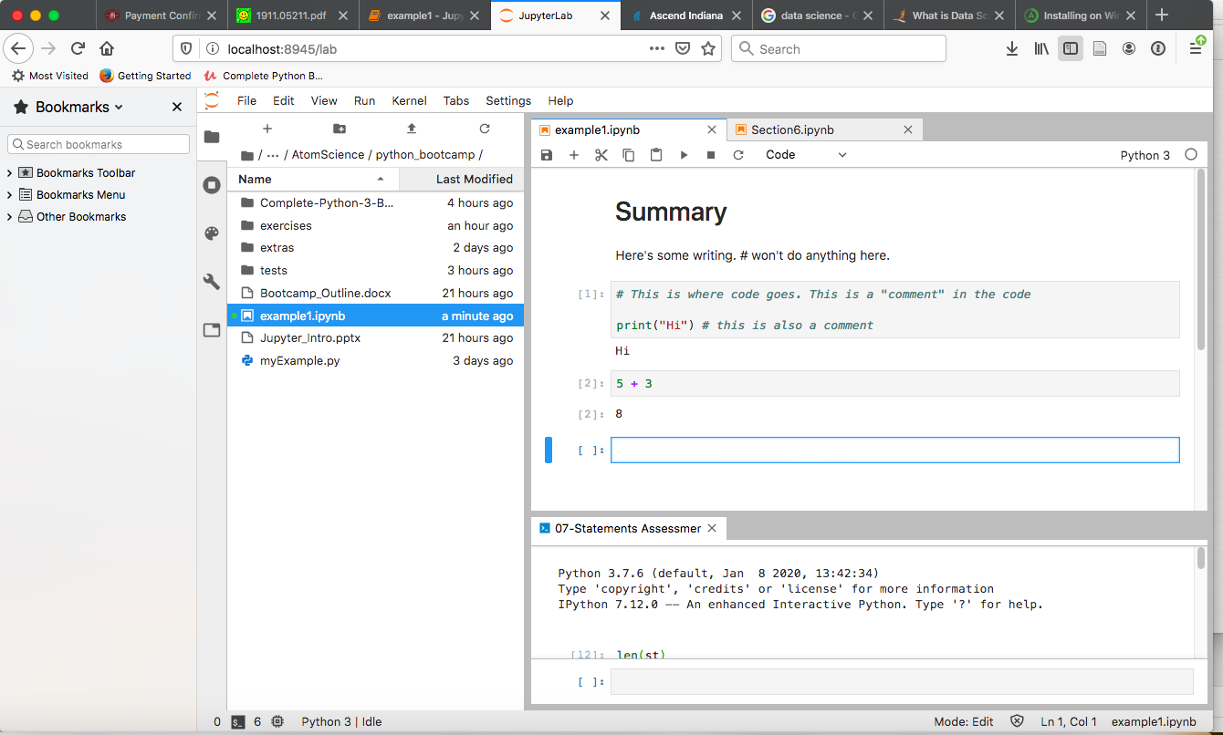
JupyterLab
Notebook
Navigation
Console

Slide 14
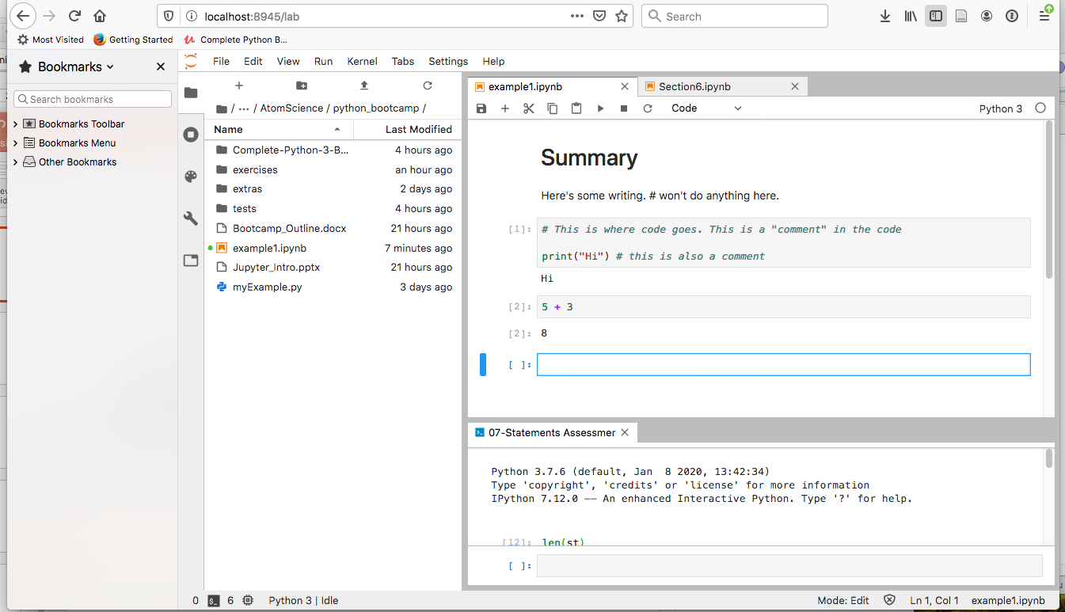
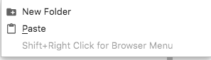
Working with the file browser
Click ’+’ to make a new notebook
Click folders to navigate
Right-click to make a new folder

Slide 15
Learning Python with Udemy
Assignments in Jupyter Notebooks, copy/paste into prompt
Quizzes: Grading can be tricky, please ask for help!
The right answer isn’t always accepted

Slide 16
Udemy Python tests
Tests are written in python notebooks
Download from https://github.com/Pierian-Data/Complete-Python-3-Bootcamp
Then add your answers into those notebooks
Try to finish before looking at the solutions
Don’t feel like you need to memorize everything
Look at previous notes/videos/google
Ask for help!

Slide 17
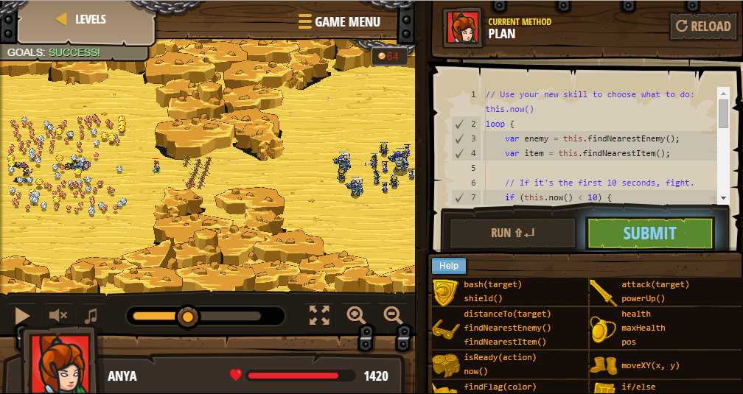
A game (optional)! codecombat.com

Slide 18
Additional learning on Udemy (optional)
Python for Data Science and Machine Learning Bootcamp
Machine Learning A-Z™: Hands-On Python & R In Data Science

